Slide 1
12TDG Portfolio
Project Planning & Development
For internal: My Inquiry Project
Other team members (if any):

Slide 2
Contents
Your MVP
Project Reminders: Due Dates
Project plan
Project implications
Sprint Plans
Sprint 1 Sprint 2
Sprint 3 Sprint 4
Project Evaluation
Your Final Outcome
Self-checklist
What you will find inside

Slide 3
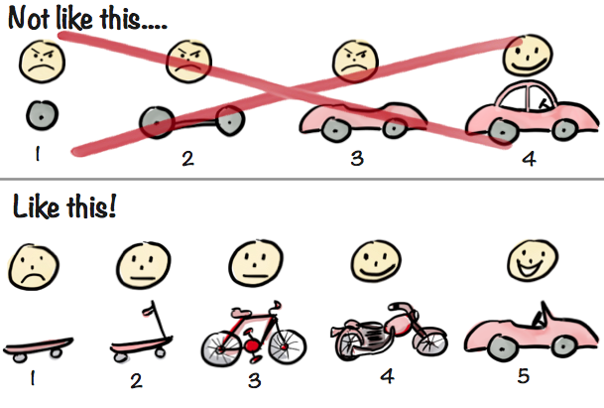
Building The MVP: Your Minimum Viable Product
Sprint development helps us to:
Focus on the biggest need of the end-user
Deliver the smallest thing that will allow testing and get feedback
So, think about what your ‘skateboard’ will be in each sprint
Story about MVP here

Slide 4
Project Reminders
Sprint 1 begins 25 May
Sprint 2 begins 15 June
Sprint 3 begins 20 July
Sprint 4 begins 10 Aug
Prototype Due
30 August 2026
Portfolio Due
18 October 2026

Slide 5
Project Plan
https://github.com/users/Shist1145/projects/5
https://github.com/Shist1145/StevenShi-Year12-Project This GitHub Project board will be used to plan and track my development work across four sprints. I will use it to organise tasks, record progress, and manage testing and feedback.
https://gemini.google.com/app/ab29350c920b47e7

Slide 6
Project Summary
What you’re making A website-based school infrastructure reporting system.
Who you’re making it for
Students who need to report school infrastructure issues.
Why you’re making it
To make school issue reporting clearer, faster, and fairer.
Recap from your Proposal

Slide 7
My Digital Outcome is: A website-based reporting system
The end users of my prototype are Student need to report school infrastructure issues. The secondary users are school staff and maintenance workers who need to review, manage, and respond to reports.
The purpose of my digital outcome is to make school issue reporting clearer, faster, and fairer. The system helps students provide clear information and helps staff manage reports more efficiently.

Slide 8
Project Implications
Social
Cultural
Legal
Ethical
Intellectual property
Privacy
Accessibility
Usability
Functionality
Aesthetics
Sustainability and future proofing
End-user considerations
Health and safety
Identify the implications on how your outcome:
Would be used and
Influences it could have by using it

Slide 9
Implication 1: Usability
This implication is about making the system that is easy to understand.
It’s important for my outcome because students need to report issues quickly. If the system is confusing, students may not complete the report correctly.
I will address this implication during development by using clear labels, simple navigation, helpful error messages, and status labels. I will also test the form and dashboard with users and improve the layout based on feedback.
Notes:
Define, Describe and Discuss

Slide 10
Implication 2: Aesthetic
This implication is about protecting student information and any evidence submitted through the system.
It’s important for my outcome because reports may include names, locations, descriptions, or photos. These could include personal information or other students in the background.
I will address this implication during development by only collecting necessary information. I will avoid displaying personal details publicly. If photo upload is added later, users will be reminded to focus only on the damaged area.
Notes:
Define, Describe and Discuss

Slide 11
Implication 3: Usability
This implication is about making sure the system works as intended.
It’s important for my outcome because users must be able to submit reports, view reports, and track report status. If these features do not work, the system will not solve the problem.
I will address this implication during development by testing each component separately. I will test the report form, validation, dashboard, detail view, and status update feature before combining them into the final prototype.
Notes:
Define, Describe and Discuss

Slide 12
Sprint 1
Starting from 25 May

Slide 13
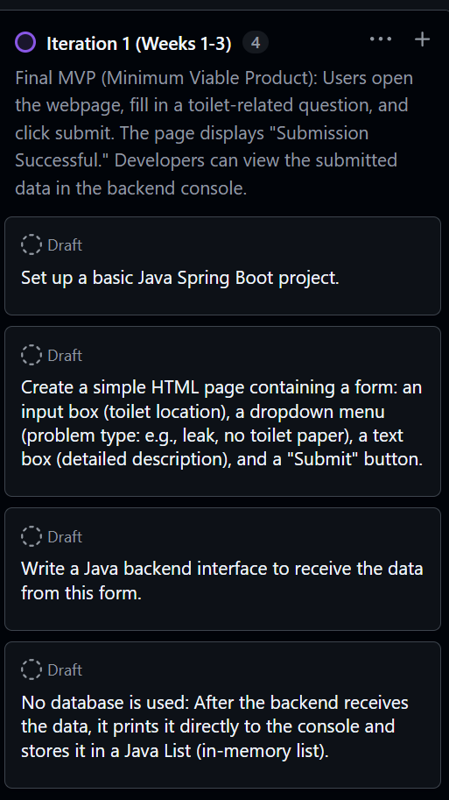
Sprint 1 Plan
Goal: test the smallest useful student reporting workflow.
1
Form
2
Validation
3
Submit
4
Feedback
Student enters name, location, issue type, priority, and description.
The page blocks empty reports and shows a clear message.
The first version proves that the report workflow makes sense.
Classmate testing shows what must change in Sprint 2.
Sprint scope
Not in Sprint 1
- One student page
- No database yet
- Basic report fields
- No teacher dashboard yet
- Required-field validation
- No login system yet
- Simple feedback message
- No extra features without testing
Evidence
Sprint 1 was kept small so testing could focus on the basic report workflow before adding a database or teacher features.
Notes:
What will you work on this sprint? - Insert evidence of your sprint backlog above

Slide 14
Sprint 1 Backlog
Work is split into build, test, and record tasks.
Build
Test
Record
HTML page
Complete report
GitHub upload
Form fields
Missing name
Feedback notes
Submit button
Missing description
Sprint review
Success/error message
Form reset
Next sprint decision
Process link
The backlog breaks the outcome into build, test, and record tasks. This gives clear planning evidence for AS91897.

Slide 15
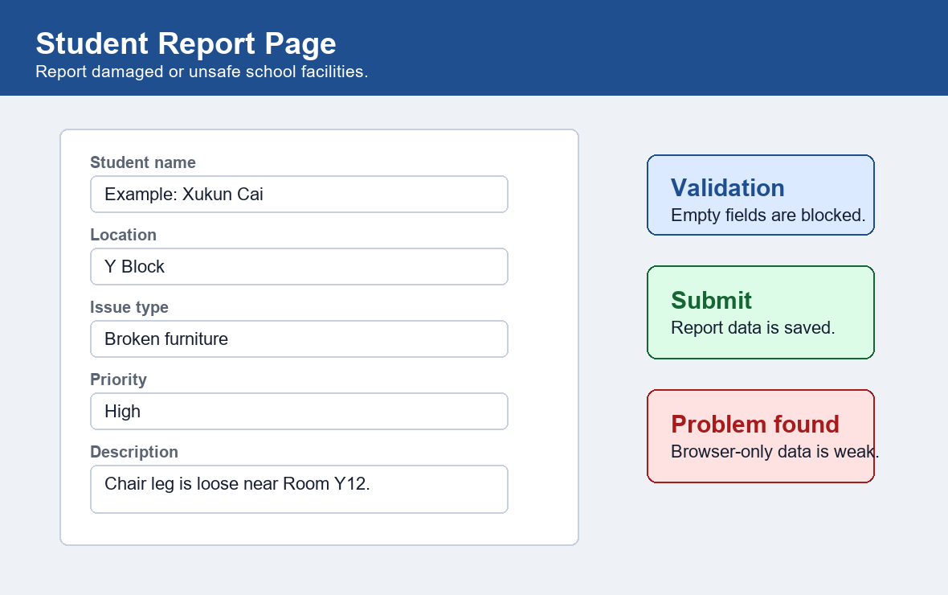
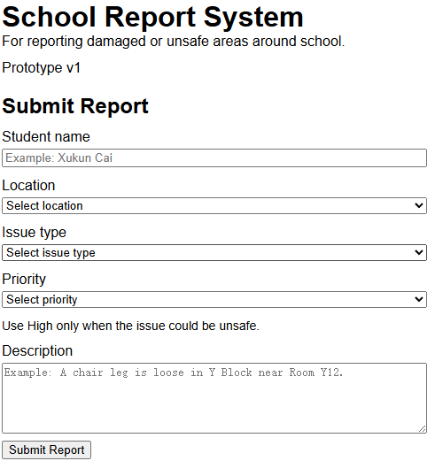

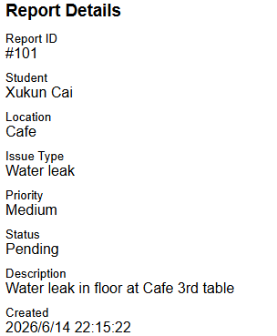
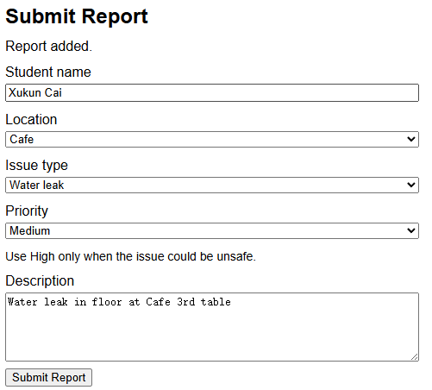
Task 1: Build Basic Student Report Form
Evidence: first working student report page.
What I built
- Student name, location, issue type, priority, description
- Required fields before submit
- Error and success messages
- Simple layout for first user testing
HTML
CSS
JavaScript
Finding from Task 1
The form worked, but browser-only storage and one-page teacher/student use were weak. That became Task 2.
Programming link
JavaScript controls validation and submit behaviour. This is evidence that the first version had working program logic.

Slide 16
Task 1 Testing and Feedback
Testing showed what should stay simple and what must change.
Test cases
Feedback
Complete form
The form is clear enough, but students and teachers should not use the same page.
Pass
Missing field
Pass
Long text
Accept
Decision for Sprint 2
Refresh page
Problem
- Add database storage
- Split student and teacher pages
- Keep the interface simple
Testing link
Testing showed the form worked, but browser-only storage was weak. This feedback became the reason for Task 2.

Slide 17
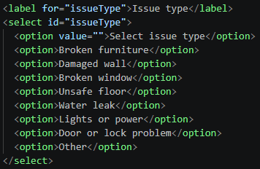
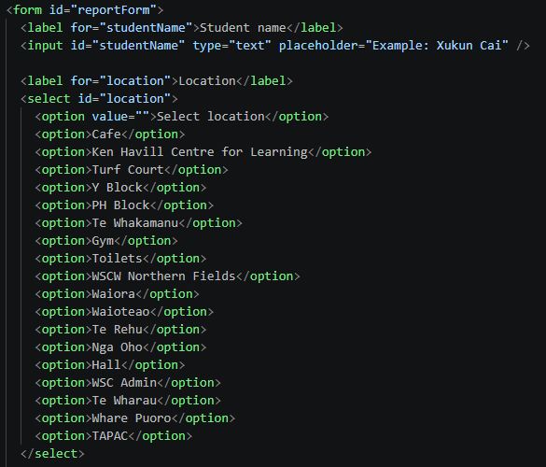
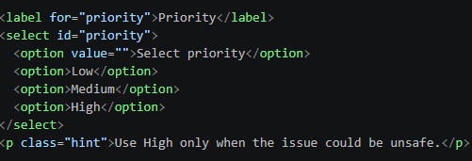
2

Slide 18
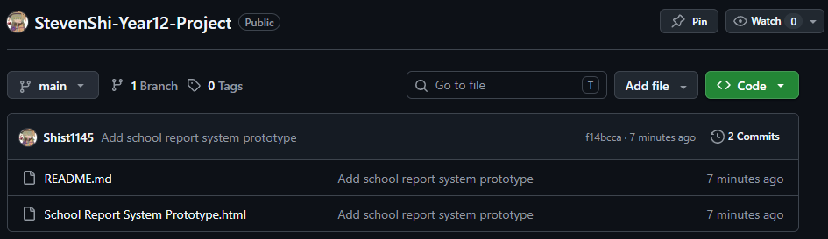
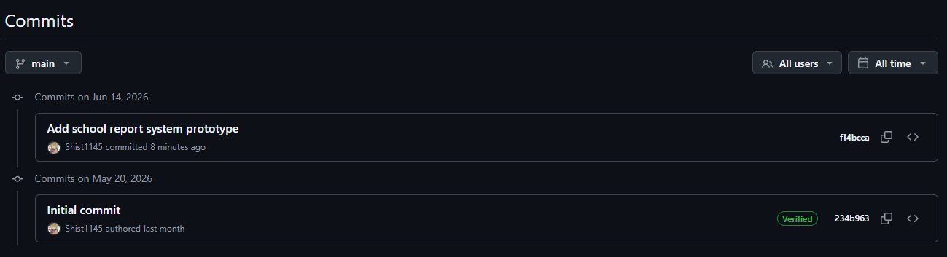

Slide 19
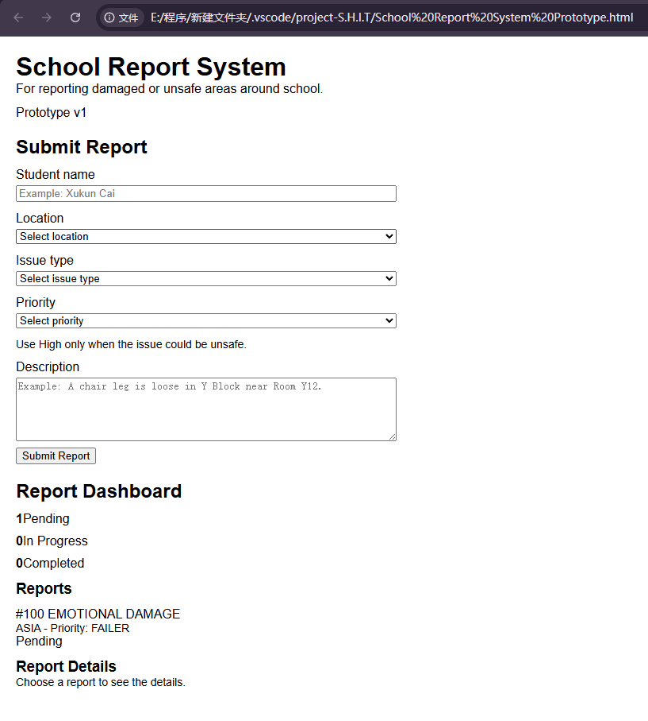

Slide 20
Sprint 1 Review
Result: useful first MVP, but not enough for real staff workflow.
Worked
Problem
Next
Student report form works
Browser-only storage is weak
Move to database and teacher page
Sprint 1 summary
The MVP proved the basic reporting process. Testing also showed that reports must persist after refresh and that teacher actions need a separate area. Sprint 2 will focus on storage and workflow separation.
Sprint decision
Sprint 1 proved the report workflow, then showed the need for persistent data and separate teacher use.

Slide 21
Sprint 2
Starting from 15 June

Slide 22
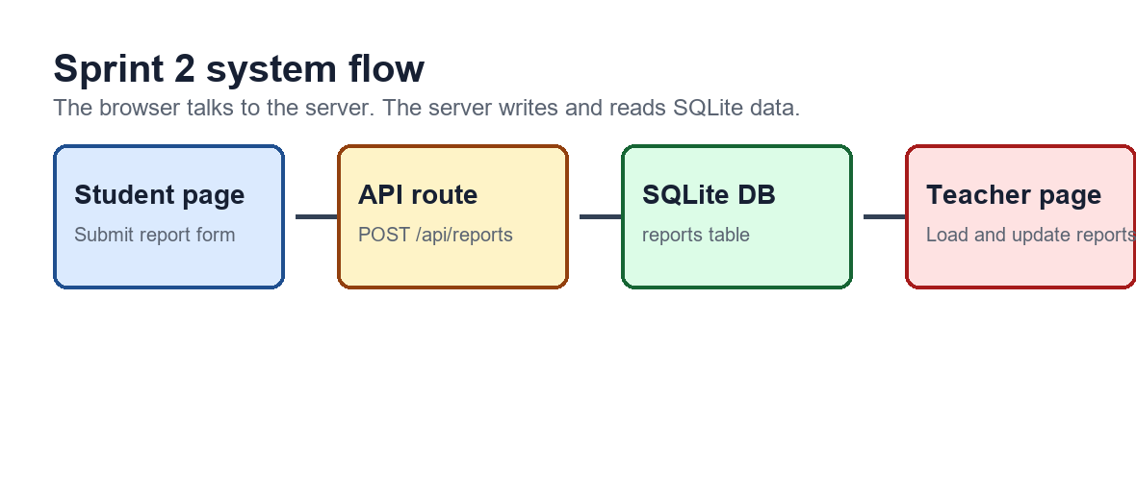
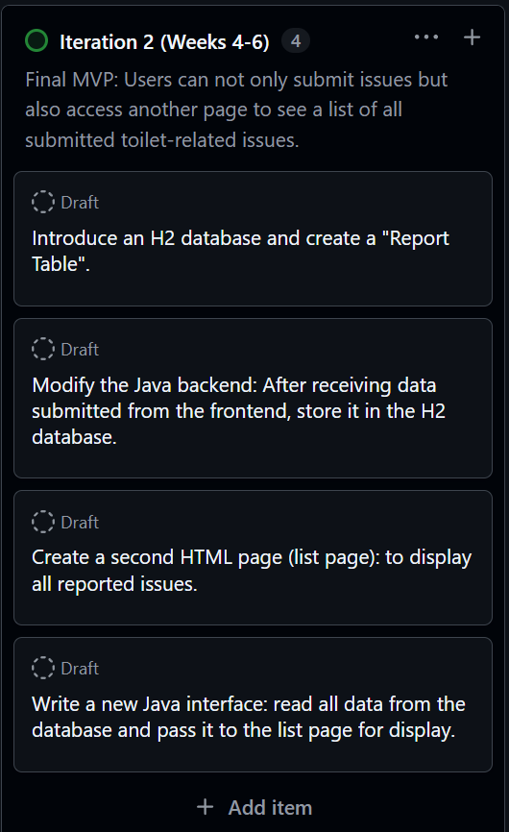
Sprint 2 Plan
Goal: change the prototype into a small client-server system.
Scope
Python server + SQLite database + separate student and teacher pages. This is still a prototype, not a full login system.
Architecture link
Sprint 2 changes the system from one browser page into a client-server prototype using Python and SQLite.
Notes:
What will you work on this sprint? - Insert evidence of your sprint backlog above

Slide 23
Sprint 2 Backlog
Database work and teacher workflow are now the main tasks.
Backend
Student side
Teacher side
server.py
Submit-only page
Report list
SQLite reports table
Field validation
Status counts
POST /api/reports
API error message
Detail panel
GET /api/reports
Success message
Update/delete actions
Development link
This backlog covers CRUD behaviour: create, read, update, and delete. These are the core database actions.

Slide 24
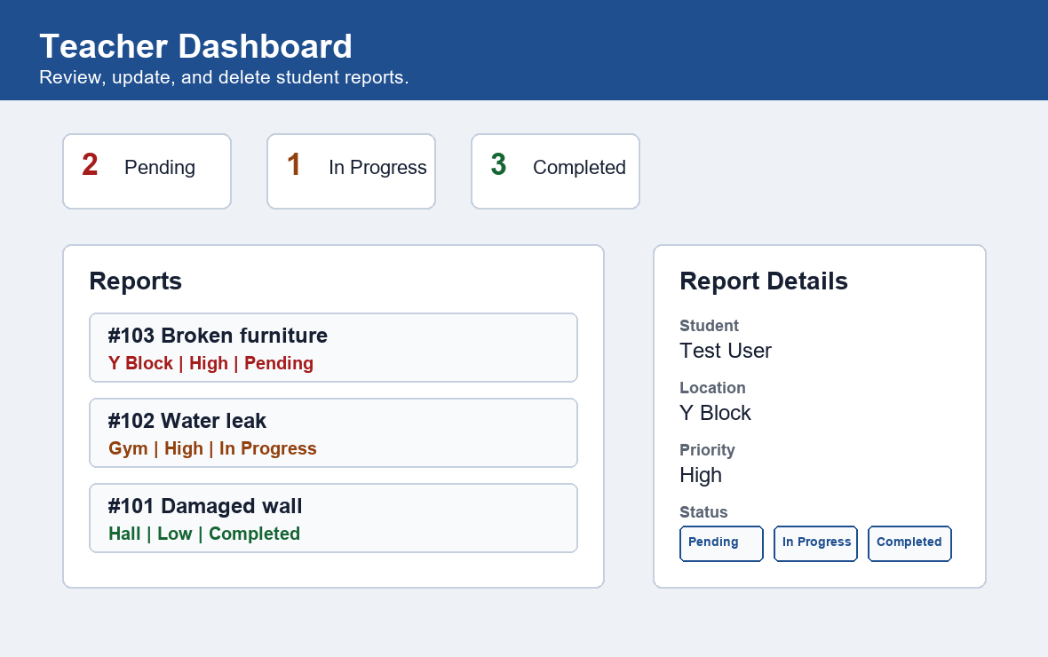
Task 2: Add Database and Teacher Page
Evidence: reports now use API routes and SQLite storage.
What changed
- Student page sends reports to the server
- server.py writes reports into SQLite
- Teacher page loads saved reports
- Teacher can update status or delete reports
Python
SQLite
API
Testing result: create, read, update, and delete report actions passed with a temporary test database.
Task 2 evidence
Testing proved that reports can be saved, loaded, updated, and deleted through the API and database.

Slide 25
Sprint 2 Review
Result: stronger workflow, better storage, still a prototype.
Role split
Database
Students submit. Teachers review and manage.
Reports can load again after refresh.
Testing
Limit
CRUD actions were checked through the API.
Teacher key is simple, not real authentication.
Next sprint: only add search, filtering, or error handling if testing shows it saves teacher time.
Evaluation link
The sprint improved functionality, but the teacher key is still only a prototype control, not a real login system.

Slide 26
Sprint 3
Starting from 20 July

Slide 27
Notes:
What will you work on this sprint? - Insert evidence of your sprint backlog above

Slide 31
Sprint 4
Starting from 10 August

Slide 32
Notes:
What will you work on this sprint? - Insert evidence of your sprint backlog above

Slide 36
Evaluation
Explain how this information led to the development of a high-quality outcome
Bring together all the elements of planning, trialling & testing

Slide 37
Final Evaluation
Discuss how the information from planning, testing and trialling of all the components has helped you to develop a high-quality outcome.
Include in your discussion how you used a range of sources such as user feedback, trialling, testing and research.
Keep your answer concise.

Slide 38
My Evaluation

Slide 39
Final Outcome
Your prototype should be:
Digital
Functioning
Accessible by your teacher
Tell your teacher where to find your project

Slide 40
How to access my digital outcome

Slide 41
Self Checklist
Use the self-checklists to ensure you have completed all the steps for grades
Can you check my work?

Slide 42
Insert your own Completed Checklist

Slide 43
Assessment Schedule
AS91893 - Digital Media
AS91896 - Programming
AS91897 - Processes
Check what exactly you are being marked against

Slide 44
Assessment Schedule - Digital Media (AS91893)
Achievement
The student has used advanced techniques to develop a digital media outcome, by:
Using appropriate tools and techniques for the purpose and end users
Applying appropriate data integrity and testing procedures
Using relevant conventions for the media type
Explaining relevant implications
Achievement with Merit
The student has used advanced techniques to develop an informed digital media outcome, by:
Using information from testing procedures to improve the quality of the outcome
Applying relevant conventions to improve the quality of the outcome
Addressing relevant implications
Achievement with Excellence
The student has used advanced techniques to develop a refined digital media outcome, by:
Iterative improvement throughout the design, development and testing process to produce a high-quality outcome
Using efficient tools and techniques in the outcome’s production

Slide 45
Assessment Schedule - Programming (AS91896)
Achievement
Use advanced programming techniques to develop a computer program involves:
writing code for a program that performs a specified task
using advanced techniques in a suitable programming language
setting out the program code clearly and documenting the program with comments
testing and debugging the program to ensure that it works on a sample of expected cases.
Achievement with Merit
Use advanced programming techniques to develop an informed computer program involves:
documenting the program with appropriate names and comments that describe code function and behaviour
following common conventions for the chosen programming language
Achievement with Excellence
Use advanced programming techniques to develop a refined computer program involves:
ensuring that the program is a well-structured, logical response to the specified task

Slide 46
Assessment Schedule - Processes (AS91897)
Achievement
Use advanced processes to develop a digital technologies outcome involves:
using appropriate project management tools and techniques to plan the development of a digital technologies outcome
decomposing the outcome into smaller components
trialling the components of the digital technologies outcome
testing that the digital technologies outcome functions as intended
explaining relevant implications.
Achievement with Merit
Use advanced processes to develop an informed digital technologies outcome involves:
effectively using project management and version control tools and techniques to manage the development of a digital technologies outcome
trialling multiple components and/or techniques and selecting those which are most suitable
using information appropriately from testing and trialling to improve the functionality of the digital technologies outcome
addressing relevant implications.
Achievement with Excellence
Use advanced processes to develop a refined digital technologies outcome involves:
discussing how the information from planning, testing and trialling of components assisted in the development of a high-quality outcome.

